Slide 1




Notes:
https://www.cloudskillsboost.google/paths/118/course_templates/539

Slide 2
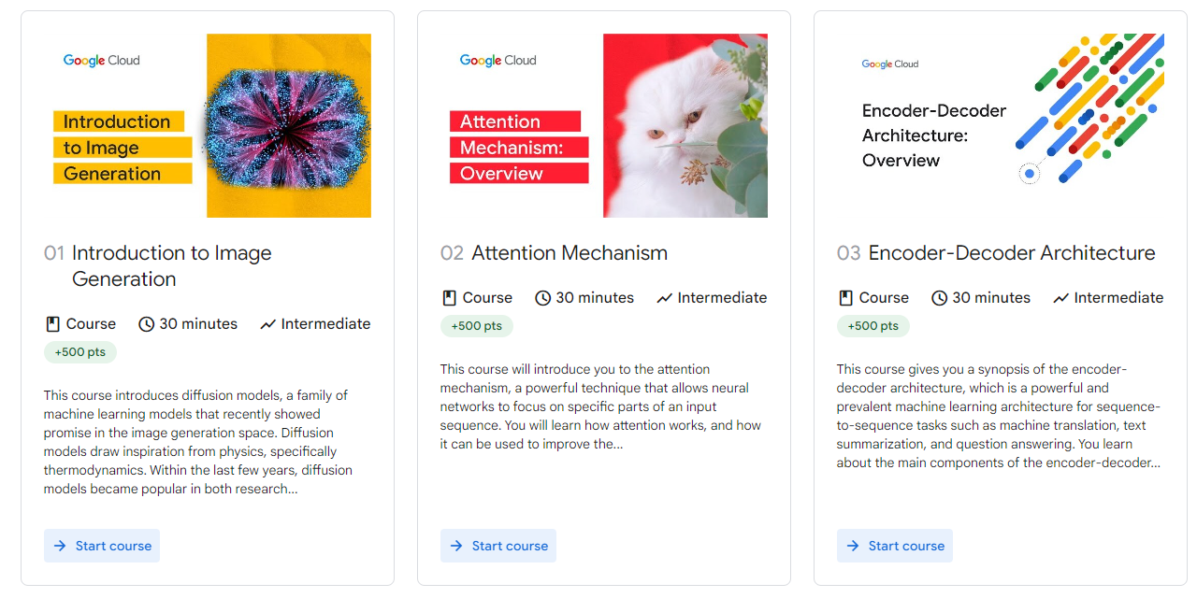

Slide 3
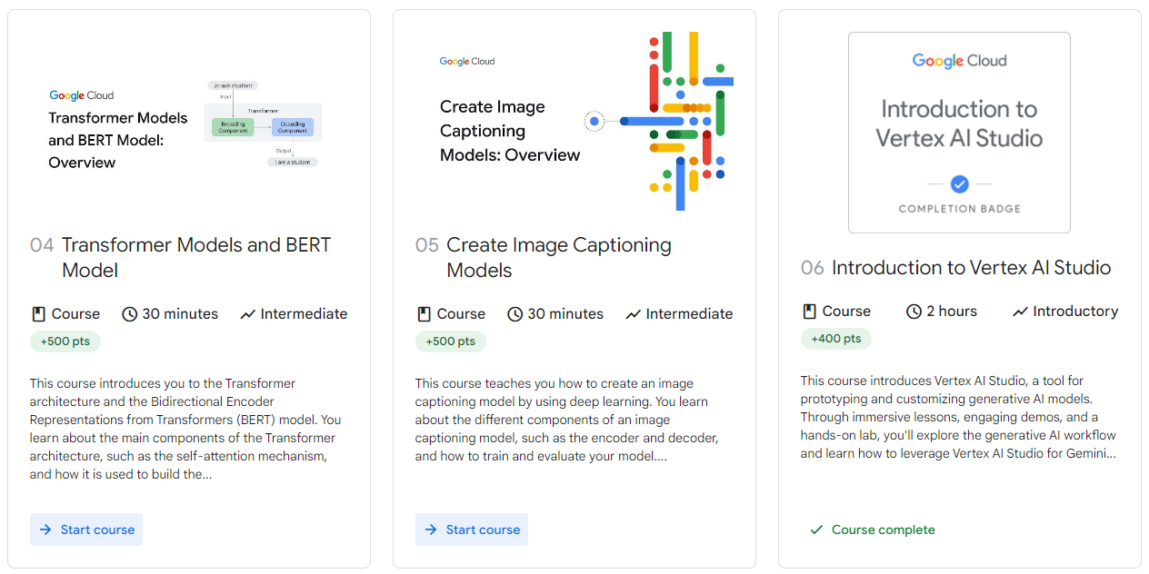

Slide 4
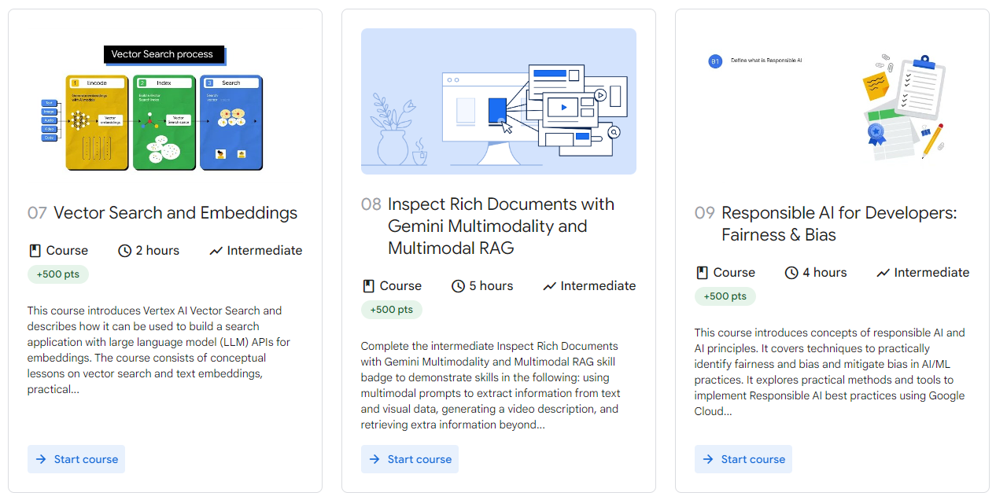

Slide 5


Slide 6
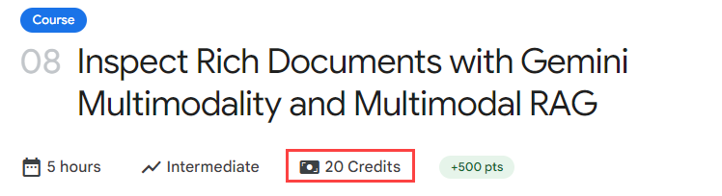

Slide 7
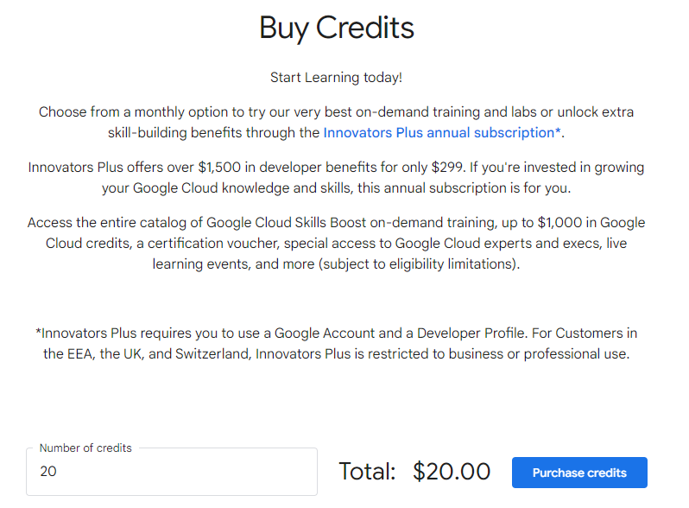
Notes:
https://www.cloudskillsboost.google/payments/buy_credits

Slide 8
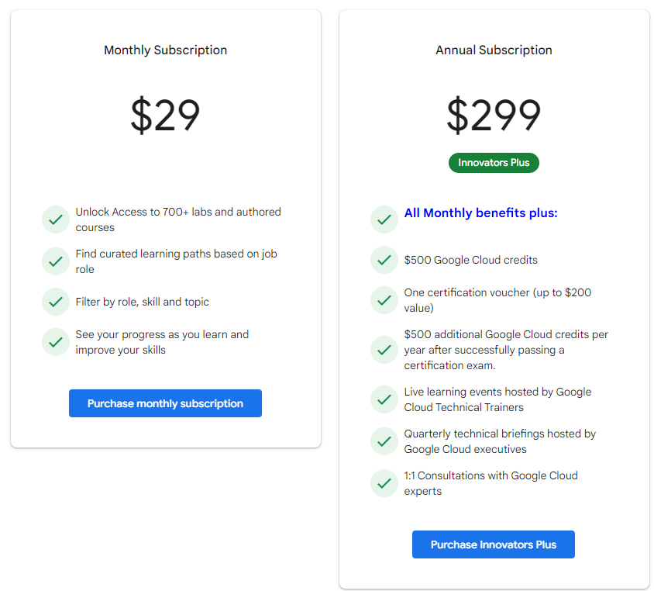
Notes:
https://www.cloudskillsboost.google/payments/new

Slide 9
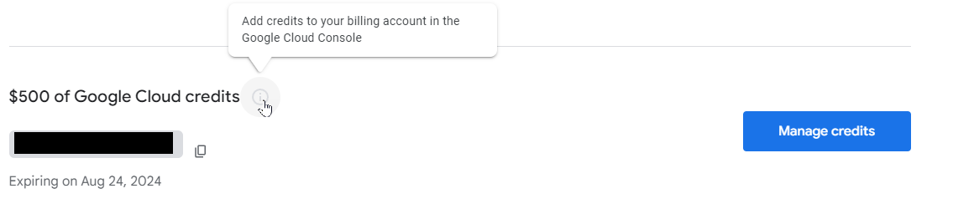
Notes:
https://cloud.google.com/innovators/plus?hl=en

Slide 10


